Slide 1
Challenges in Dissemination: Meeting Users’ Needs with Limited Resources
Niamey, 13 – 15 May 2014
by
S . Mungralee
Senior Statistician
Statistics Mauritius

Slide 2
Current PRACTICE
Print publications reproduced online
Dedicated web releases

Slide 3
Current PRACTICE
Print publications reproduced online
Economic & Social Indicators (ESI)
Digest of Statistics
Mauritius in figures
Technical/Analytical Reports

Slide 4
Current PRACTICE (…)
Dedicated web releases
Historical series
Methodological report
Microdata
Customised tables/outputs

Slide 5
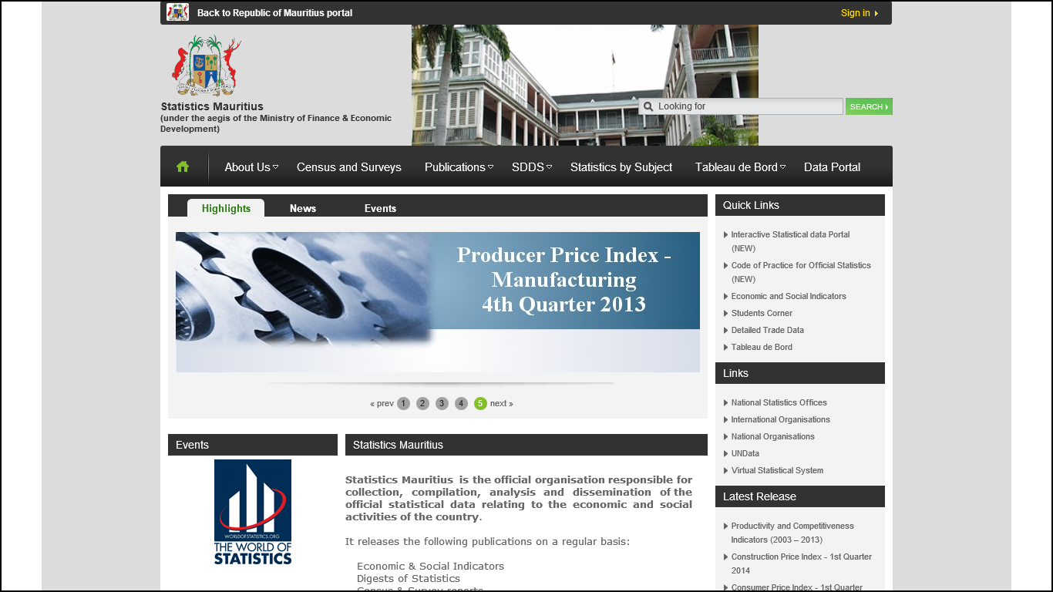
http://statsmauritius.gov.mu

Slide 6
To what extent is SM meeting users’ needs?

Slide 7
. User-survey . Focus group meetings . Meetings with main stakeholders . Close interactions by SM staffs posted in Statistical Units at various Government Ministries
Assessing USERS’ NEEDS

Slide 8
. SM has been responding to most of users’ requirements . Official Statistics widely used by decision & policy makers, researchers, academia and the general public .
Assessing USERS’ NEEDS (…)
What’s positive?

Slide 9
Significant communication gap between Statistics Mauritius (SM) and its users
Assessing USERS’ NEEDS (…)
What’s needs enhancement?

Slide 10
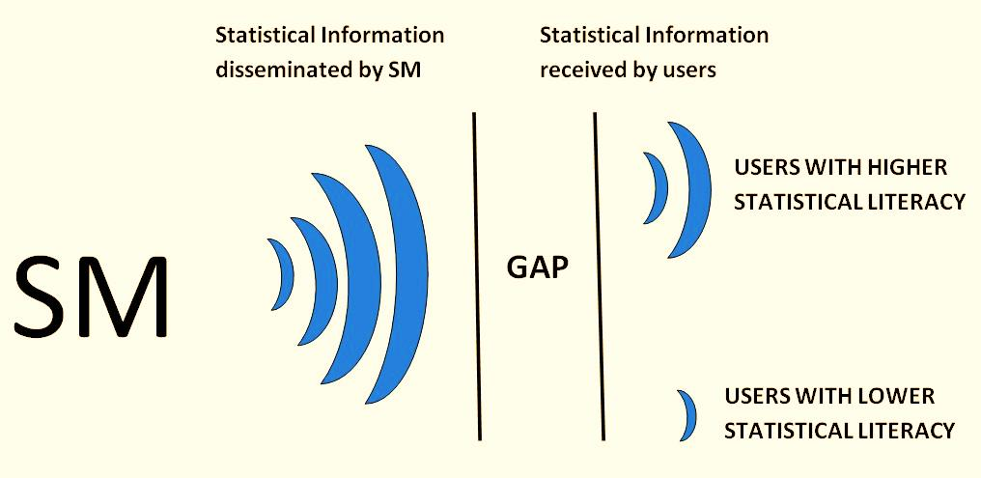

Slide 11
Change in profile of users: More professionals & computer literates compared to some 10 years earlier
Change in users’ needs – major shift from primary to tertiary sector
Emerging areas of interest (Globalisation, Ocean Economy, Financial sector is becoming more stronger)
Inadequate statistical literacy of users
Reasons for gap

Slide 12
SOME CHALLENGES
Need more resources – Human & Financial
Need more IT professionals to enhance web
Not easy to change the mindset of the staffs
Increasing number of user categories
Not practical to address needs of every category separately

Slide 13
Remedial ACTIONS
Gear dissemination more closely to user needs
Improve presentation of statistical information
Promote Statistical literacy

Slide 14
Identification of User Categories and User Needs
Distinguish between users on basis of:
(i) needs
(ii) interest and
(iii) level of statistical literacy

Slide 15
Identification of User Categories and User Needs (…)
Two main categories identified:
General Public who need official statistics mainly for informational needs and who may not have a high level of statistical literacy
Professional users who use official statistics for decision making and who may have a higher level of statistical literacy

Slide 16
Improving dissemination -
Catering for user specific needs
Separate sets of publications for informational needs of general public and decision making needs of professional users.
Publications by themes for professional users.
Comprehensive publication covering all themes for the General Public
Dedicated supplementary material (e.g. web pages) to accommodate specific needs of subgroups of professional users

Slide 17
Improving dissemination -
Catering for user specific needs
Publications for professional users
To be thematic
To consist of text supported by relevant summary tables and visualisations
To provide information, comparison, analysis and where possible future outlook

Slide 18
Improving dissemination -
Catering for user specific needs
Publications for the General Public
Comprehensive covering economic, social and environmental situation of the country.
Simple description and analysis supported by simple relevant summary tables and visualisations
To adopt simple style and language requiring minimal statistical literacy

Slide 19
Improving dissemination -
Partnering with the media
Secure media interest by providing newsworthy statistical information
Study media coverage to discover issues of interest
Provide support to media for statistical reporting

Slide 20
Improving dissemination
Make dissemination more effective by promoting statistical literacy
Sensitise government and public opinion about the importance of statistical literacy for the nation
Develop a partnership network (with media, educational institutions
Develop capability in statistical literacy education within SM (statistical literacy cell)
Develop statistical literacy material

Slide 21
Visit us at:
http://statsmauritius.gov.mu

Slide 22
Thank you

